Slide 1
Agile Presentation
CS-250
Terry Christmas
8/13/2023

Slide 2
Overview
The Scrum – Agile approach was used to develop the SNHU Travel Application
We will discuss the various roles utilized in the Scrum team and describe importance
Cover the difference between the Scrum - agile and waterfall development lifecycle
Review factors between choosing between the two methods

Slide 3
Product Owner
Key Responsibilities
Engage with the client (customer) and Scrum team
Create user stories to determine acceptance criterion within the software.
Liaison between the customer and scrum team for any changes or issues.
Create the User Stories documentation to present to the Scrum Team

Slide 4
Scrum Master
Key Responsibilities
Main communication between Product Owner and Scrum team
Create Agile Scrum Events
Sprint Planning
Daily Scrum Meetings
Sprint Reviews
Backlog Refinements
Create Agile Team Charter
Includes Role Information
Success Criteria
Risks
Communication Guidelines
Expected Rules of Behavior
Determine best action plan for any impediments that are in the project

Slide 5
Developer
Key Responsibilities
Develop source code for product.
Ability to adapt to any changes in product
Needs to communicate with Scrum Master for any impediments in product development.
Use the User Stories and Test Cases documentation to develop code to align with changes or bugs in source code.

Slide 6
Tester
Key Responsibilities
Create Test Case documentation to update Developer and Scrum Master
Communicate with Developer for any known issues or bugs in application.
Update Scrum Master with program test cases and performance.

Slide 7
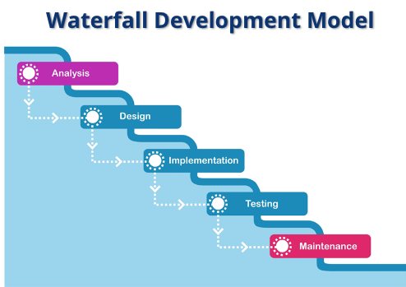
Agile vs Waterfall
Waterfall is more traditional that is used with detailed planning and documentation prior to development.
Each step is linear and sequential requiring the predecessor to be finished before continuing to the next task.
This was stressful for project teams and wanted to develop an alternative methods.
SNHU, C.-250. (2023). WaterFall Development Model Image.
CS250-Module One: SDLC methodologies. http://snhu-media.snhu.edu/files/course_repository/undergraduate/cs/cs250/storyline/mod1/story_html5.html

Slide 8
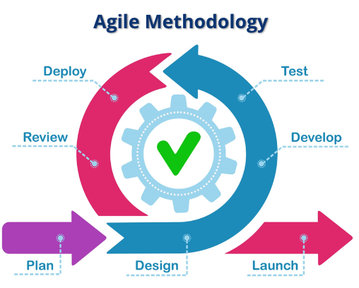
Agile vs Waterfall
Agile is an adaptive approach to be able to complete each step simultaneously.
Each step has a role that relies on each sprint owner to update each other on any changes.
This Method is more fluid working as a team.
SNHU, C.-250. (2023). Agile Methodology Model Image.
CS250-Module One: SDLC methodologies. http://snhu-media.snhu.edu/files/course_repository/undergraduate/cs/cs250/storyline/mod1/story_html5.html

Slide 9
Factors Selecting Method
Creating a product that is extensive, large teams, high risks, large scale of product.
Creating a product that is custom, smaller scale, smaller teams, can still have risks.
Water Fall
Agile

